Slide 1
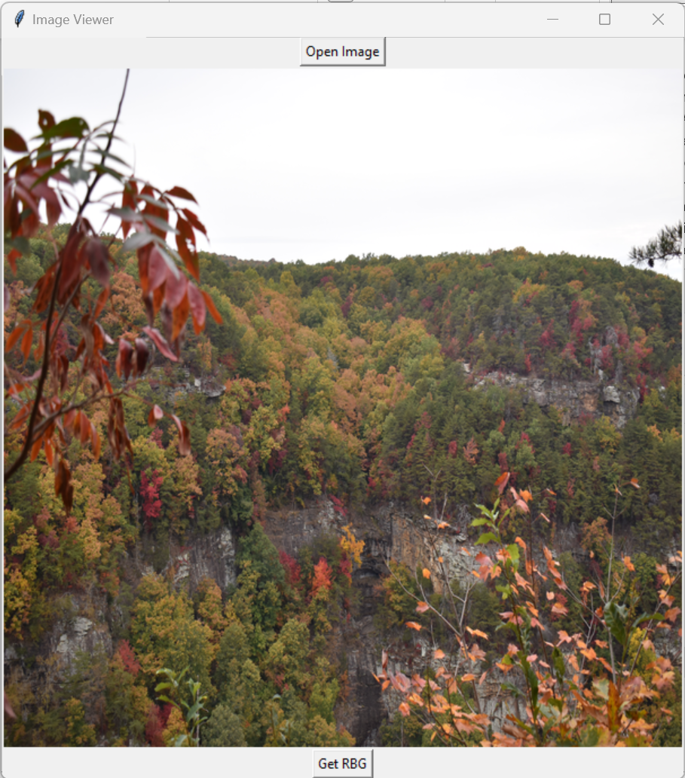
RGB Identifier
Created by: Eitan Shlomo
Are you in love with a color, but aren’t sure what specific color it is?
Leave your worries behind with the cutting edge RGB Identifier. This program allows you to view the exact color profile of where your mouse clicks on an image.
https://github.com/ksu-is/RGB-Identifier

